Slide 1
SWF critical depth boundary definition
I tested the sensitivity of the outflow for the abdul problem with 3 different ways of defining the critical depth outflow boundary length:
The original approach with outer boundary nodes flagged and contributing length calculated from node spacing along boundary
By assuming the length of element side 1 is the outflow boundary length
By assuming the sqrt(cell area) is outflow boundary length.

Slide 2
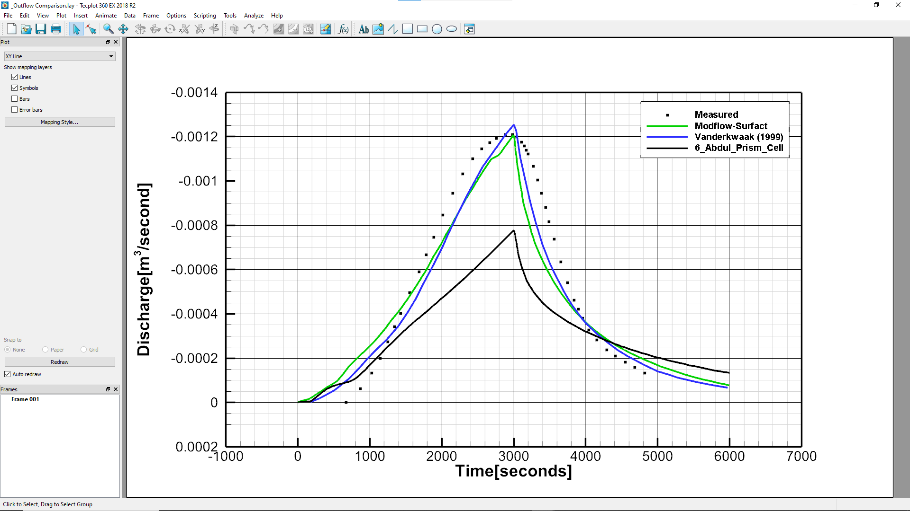
Using defined outer boundary nodes

Slide 3
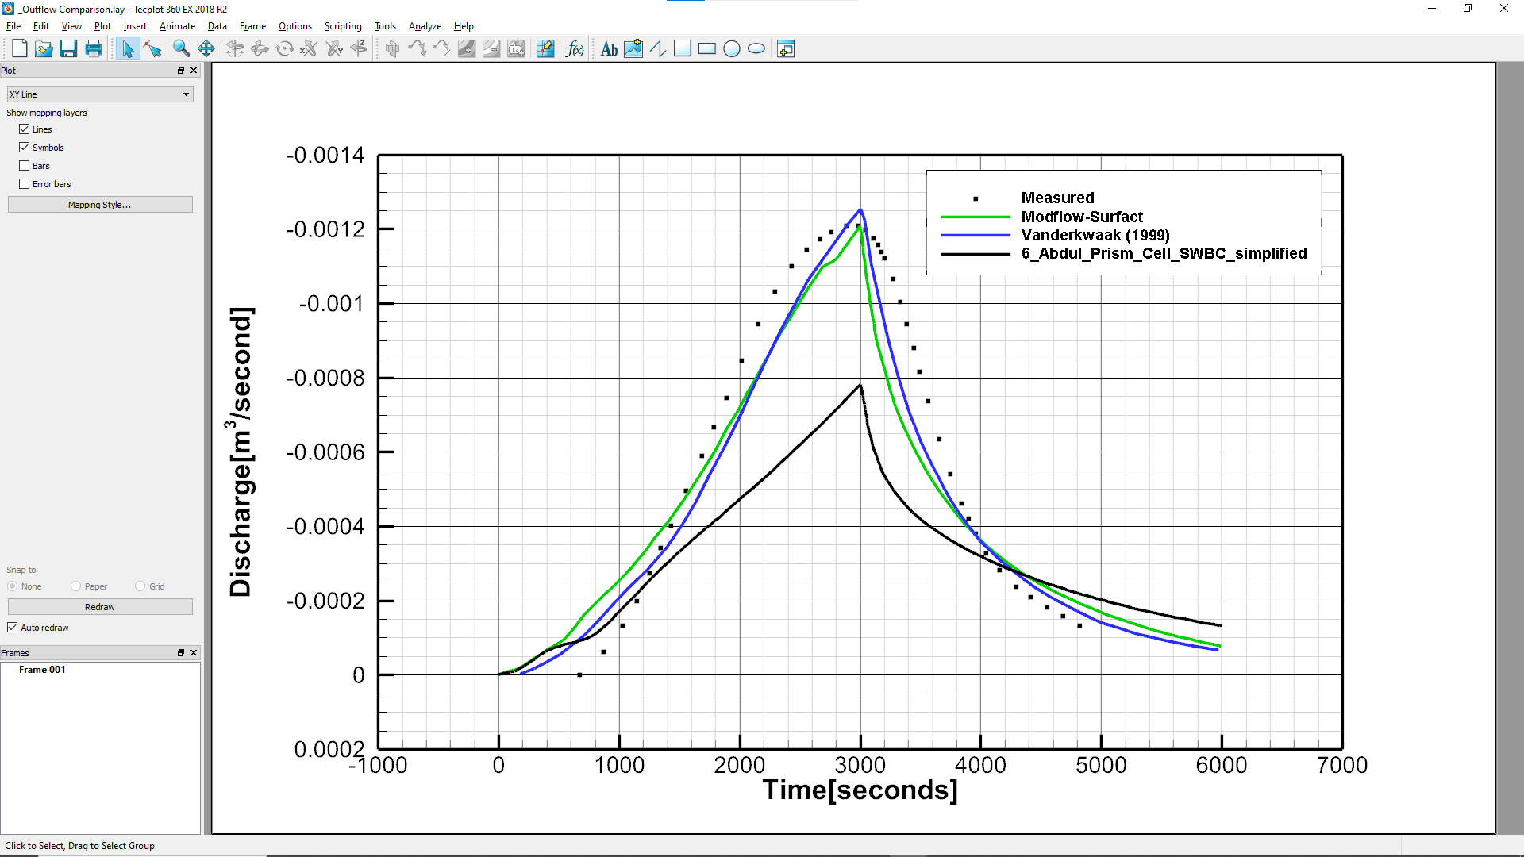
Using Side length 1

Slide 4

Using sqrt(cell area)

Slide 5
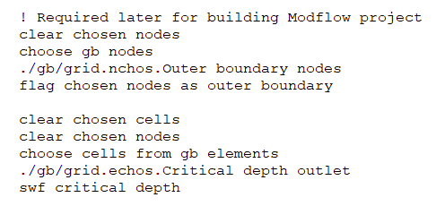
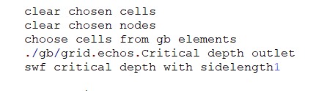
Conclusion
It doesn’t make much difference to the outflow hydrograph no matter which method we use.
I’m thinking of going with option 3, which makes the input much simpler:
We could change MUT so ‘swf critical depth’ instruction uses the simpler approach and keep the original approach but change the instruction to something like e.g. ‘swf critical depth at outer boundary’
Thoughts?
Original approach
Simpler approach

